Slide 1

Kamal Putra Pratama
Founder Of NERS Indonesia
NI-001 MED.PEN

Slide 2
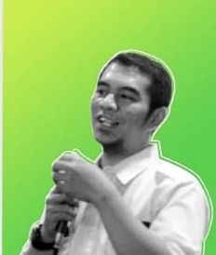
Presiden Of NERS Indonesia
Ardian Permana NI-003 MED.PER

Slide 3
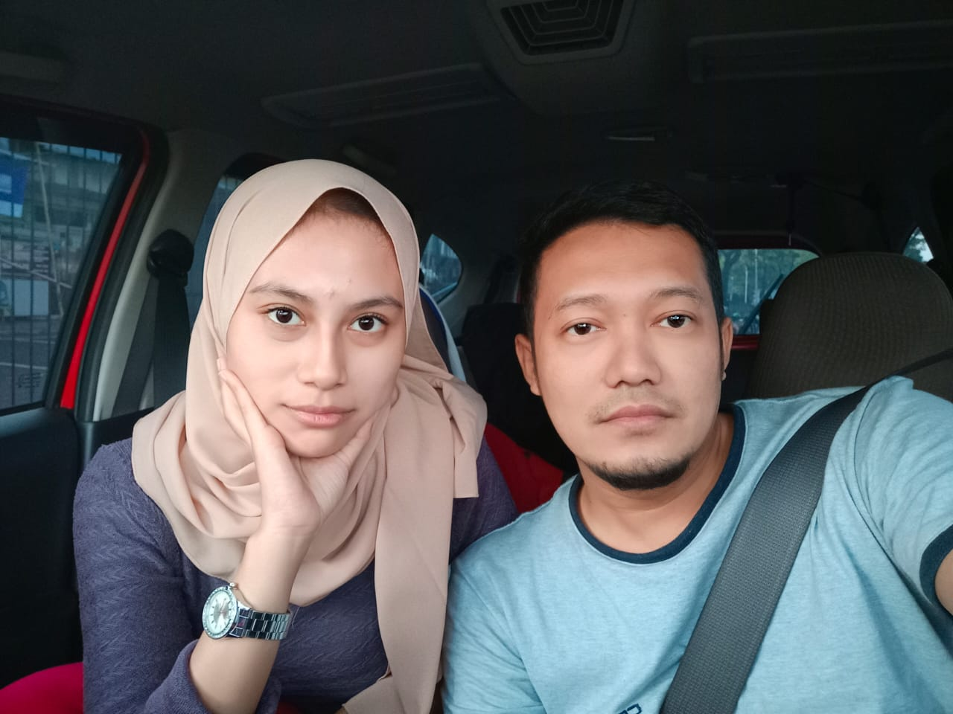
Secretaris Of NERS Indonesia
NS. Vika Andriani.S.Kep
NI-032 MED

Slide 4

Head Of Disaster Mapping Of NERS Indonesia
Ihfa Farasiar NI-031 NMED

Slide 5

Division Logistic and Medic Of NERS Indonesia
M.Ali Ridho, S.Kep NI-035 MED

Slide 6

Head Consultan Of NERS Indonesia
Dody Mangku Alam
NI- 201 MED-Consultan

Slide 7
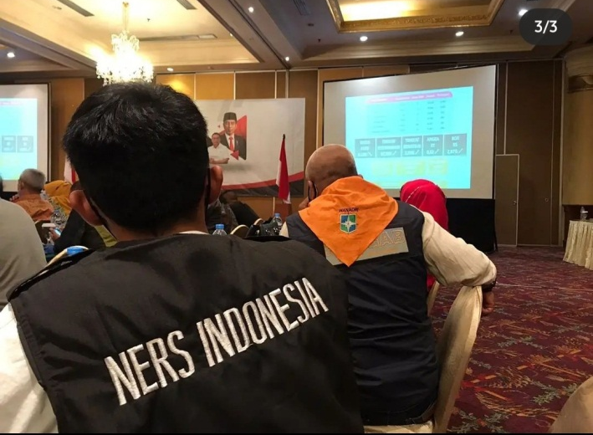
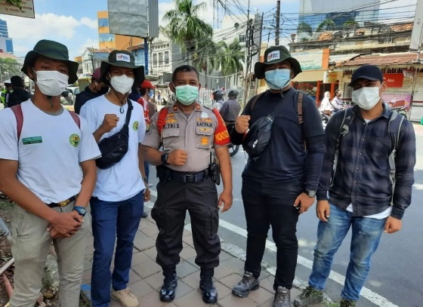
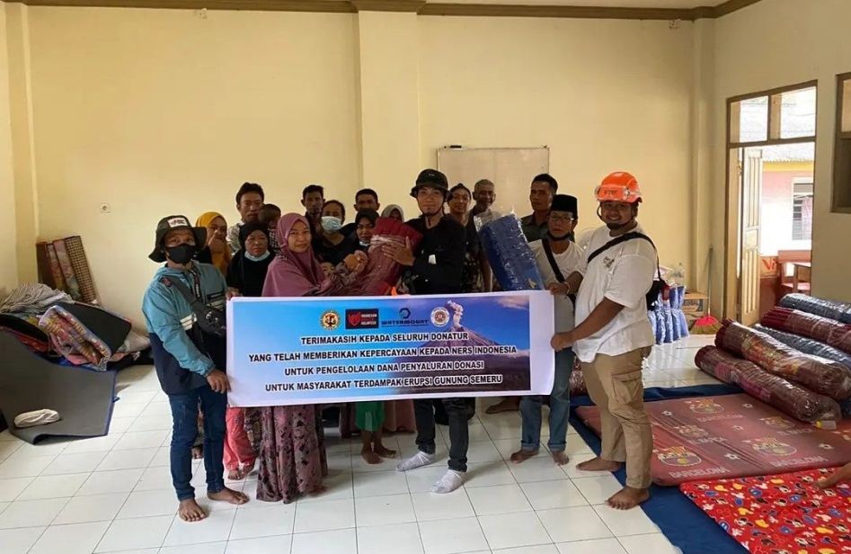

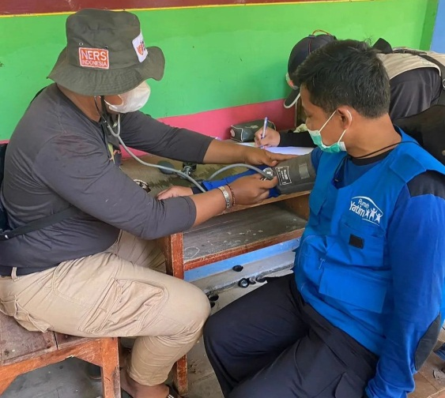

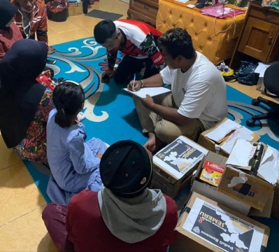
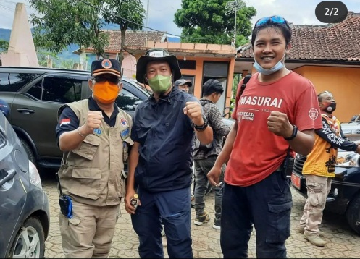

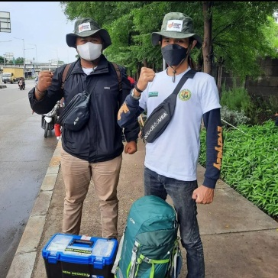
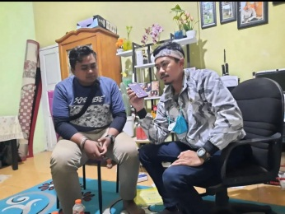
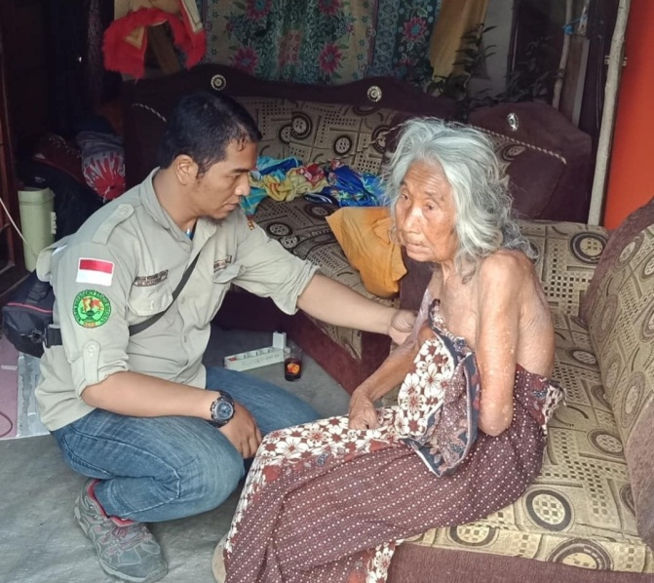
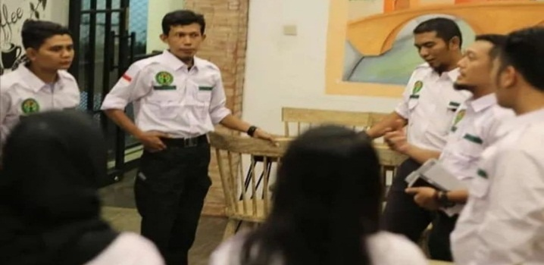
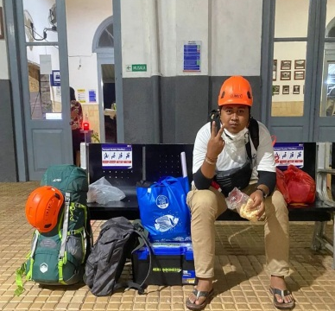
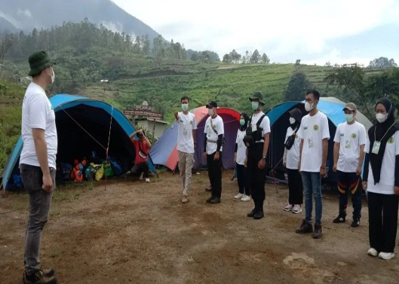
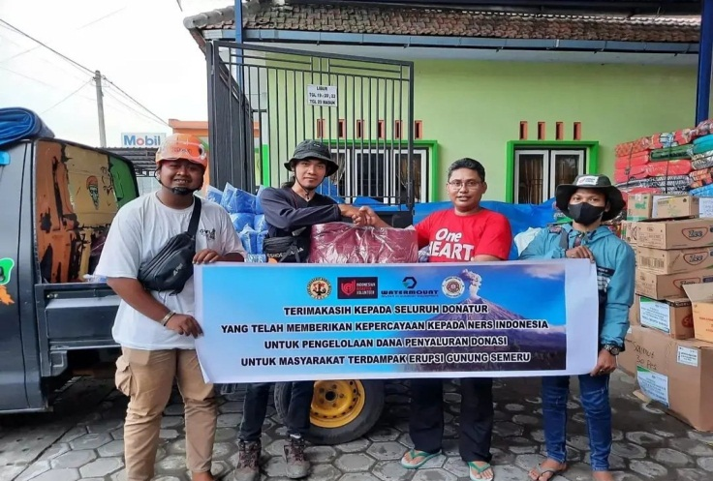
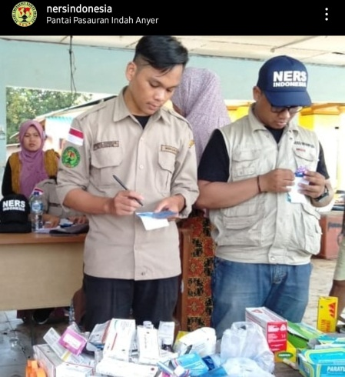
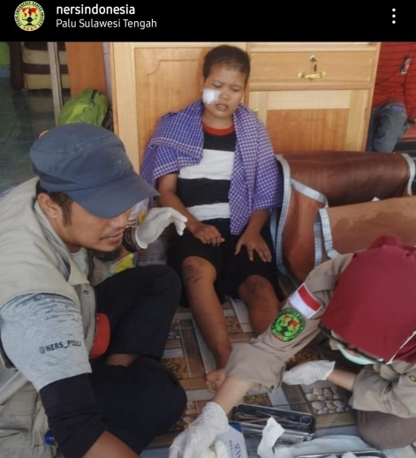
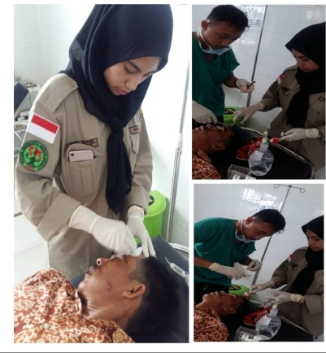
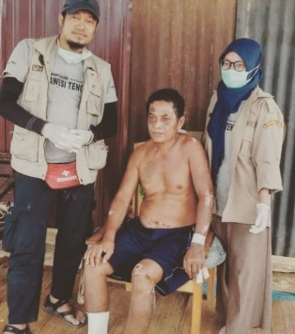




YAYASAN JEJAK RELAWAN KEMANUSIAAN
#nersindonesia #indonesiandisastervolunteers
Base Camp : Jl. Raya Cisarua Puncak no 502 Kopo Cisarua- Kab.Bogor
@nersindonesia-NGO
0821 34567 157
0821 77777 242

